Slide 1
Makers Lab
Exit
SR1
STAIRS
3
2
Exit
Tables
Chairs
Registration
1
Main entrance

Slide 2
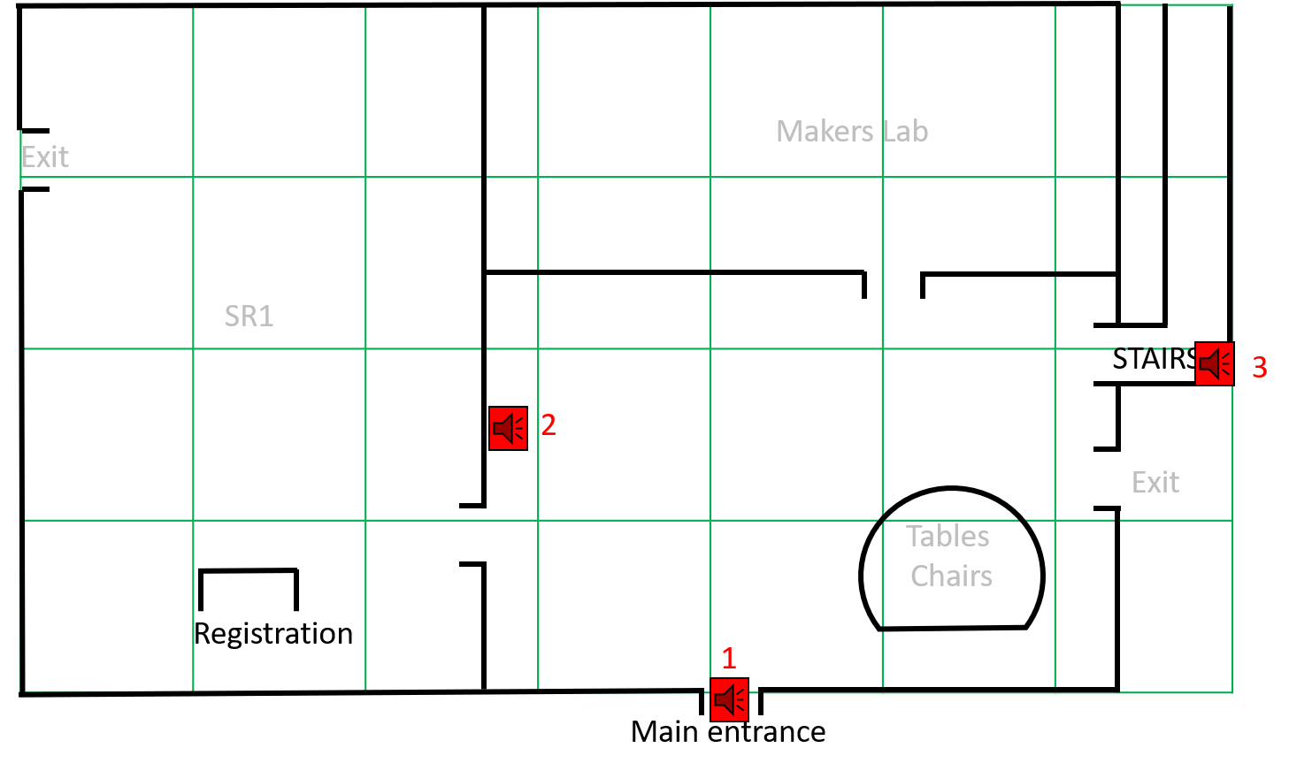

Slide 3
0 | 1 | 2 | 3 | 4 | 5 | 6 | 7 | 8 | 9 | 10 | 11 | 12 | 13 | 14 | 15 | 16 | 17 | 18 | 19 | 20 | 21 | 22 | 23 | 24 | 25 | 26 | 27 | 28 | 29 | 30 | 31 | 32 | 33 | 34 | 35 | 36 | 37 | 38 | 39 | 40 | 41
0
1
2
3
4
5
6
7
8
9
10
11
12
13
14
15
16
17
18
19
0 | 0 | 0 | 0 | 0 | 0
0 | 1 | 1 | 1 | 1 | 1
0 | 1 | 1 | 1 | 1 | 1
0 | 1 | 1 | 1 | 1 | 1
1 | 1 | 1 | 1 | 1 | 1
0 | 0 | 0 | 0 | 0 | 0
1 | 1 | 1 | 1 | 1 | 1
1 | 1 | 1 | 1 | 1 | 1
1 | 1 | 1 | 1 | 1 | 1
1 | 1 | 1 | 1 | 1 | 1
0 | 0 | 0 | 0 | 0 | 0
1 | 1 | 1 | 0 | 0 | 1
1 | 1 | 1 | 0 | 0 | 1
1 | 1 | 1 | 0 | 0 | 1
1 | 1 | 1 | 0 | 0 | 1
0 | 0 | 0 | 0 | 0 | 0
1 | 1 | 1 | 1 | 1 | 1
1 | 1 | 1 | 1 | 1 | 1
1 | 1 | 1 | 1 | 1 | 1
1 | 1 | 1 | 1 | 1 | 1
0 | 0 | 0 | 0 | 0 | 0
1 | 1 | 1 | 1 | 1 | 1
1 | 1 | 1 | 1 | 1 | 1
1 | 1 | 1 | 1 | 1 | 1
1 | 1 | 1 | 1 | 1 | 1
0 | 0 | 0 | 0 | 0 | 0
1 | 1 | 1 | 1 | 1 | 1
1 | 1 | 1 | 1 | 1 | 1
1 | 1 | 1 | 1 | 1 | 1
1 | 1 | 1 | 1 | 1 | 1
0 | 0 | 0 | 0 | 1 | 1
1 | 0 | 0 | 0 | 1 | 1
1 | 0 | 0 | 0 | 1 | 1
1 | 0 | 0 | 0 | 1 | 1
1 | 0 | 0 | 0 | 1 | 1
0
1
2
3
4
5
6
7
8
9
10
11
12
13
14
15
16
17
18
19
1 | 1 | 1 | 1 | 1 | 1
0 | 1 | 1 | 1 | 1 | 1
0 | 1 | 1 | 1 | 1 | 1
0 | 1 | 1 | 1 | 1 | 1
0 | 1 | 1 | 1 | 1 | 1
1 | 1 | 1 | 1 | 1 | 1
1 | 1 | 1 | 1 | 1 | 1
1 | 1 | 1 | 1 | 1 | 1
1 | 1 | 1 | 1 | 1 | 1
1 | 1 | 1 | 1 | 1 | 1
0 | 0 | 0 | 0 | 0 | 1
1 | 1 | 1 | 0 | 0 | 1
1 | 1 | 1 | 0 | 0 | 0
1 | 1 | 1 | 0 | 0 | 0
1 | 1 | 1 | 0 | 0 | 1
1 | 1 | 1 | 1 | 1 | 1
1 | 1 | 1 | 1 | 1 | 1
0 | 0 | 0 | 0 | 0 | 0
0 | 0 | 0 | 0 | 0 | 0
1 | 1 | 1 | 1 | 1 | 1
1 | 1 | 1 | 1 | 1 | 1
1 | 1 | 1 | 1 | 1 | 1
0 | 0 | 0 | 0 | 0 | 1
0 | 0 | 0 | 0 | 0 | 1
1 | 1 | 1 | 1 | 1 | 1
1 | 1 | 1 | 1 | 1 | 1
1 | 1 | 1 | 1 | 1 | 1
1 | 0 | 0 | 0 | 0 | 0
1 | 0 | 0 | 0 | 0 | 0
1 | 1 | 1 | 1 | 1 | 1
1 | 0 | 0 | 0 | 1 | 1
1 | 0 | 0 | 0 | 1 | 1
0 | 0 | 0 | 0 | 1 | 1
0 | 0 | 0 | 0 | 1 | 1
1 | 1 | 1 | 1 | 1 | 1
0 | 1 | 1 | 1 | 1 | 1
0 | 1 | 1 | 1 | 1 | 1
0 | 1 | 1 | 1 | 1 | 1
0 | 1 | 1 | 1 | 1 | 1
0 | 1 | 1 | 1 | 1 | 1
1 | 1 | 1 | 1 | 1 | 1
1 | 1 | 1 | 1 | 1 | 1
1 | 1 | 1 | 1 | 1 | 1
1 | 1 | 1 | 1 | 1 | 1
1 | 1 | 1 | 1 | 1 | 1
1 | 1 | 1 | 0 | 0 | 1
1 | 1 | 1 | 0 | 0 | 1
1 | 1 | 1 | 0 | 0 | 1
1 | 1 | 1 | 0 | 0 | 1
1 | 1 | 1 | 0 | 0 | 1
1 | 1 | 1 | 1 | 1 | 1
1 | 1 | 1 | 1 | 1 | 1
1 | 1 | 1 | 1 | 1 | 1
1 | 1 | 1 | 1 | 1 | 1
1 | 1 | 1 | 1 | 1 | 1
1 | 1 | 1 | 1 | 1 | 1
1 | 1 | 1 | 1 | 1 | 1
1 | 1 | 1 | 1 | 1 | 1
1 | 1 | 1 | 1 | 1 | 1
1 | 1 | 1 | 1 | 1 | 1
1 | 1 | 1 | 1 | 1 | 1
1 | 1 | 1 | 1 | 1 | 1
1 | 1 | 1 | 1 | 1 | 1
1 | 1 | 1 | 1 | 1 | 1
1 | 1 | 1 | 1 | 1 | 1
1 | 1 | 1 | 1 | 1 | 1
1 | 0 | 0 | 0 | 0 | 0
0 | 0 | 0 | 0 | 1 | 1
1 | 1 | 1 | 1 | 1 | 1
1 | 1 | 1 | 1 | 1 | 1
0 | 1 | 1 | 1 | 1 | 1
0 | 1 | 1 | 1 | 1 | 1
0 | 1 | 1 | 1 | 1 | 1
0 | 1 | 1 | 1 | 1 | 1
0 | 0 | 0 | 0 | 0 | 0
1 | 1 | 1 | 1 | 1 | 1
1 | 1 | 1 | 1 | 1 | 1
1 | 1 | 1 | 1 | 1 | 1
1 | 1 | 1 | 1 | 1 | 1
0 | 0 | 0 | 0 | 0 | 0
1 | 1 | 1 | 1 | 1 | 1
1 | 1 | 1 | 1 | 1 | 1
1 | 1 | 1 | 0 | 0 | 1
1 | 1 | 1 | 0 | 0 | 1
0 | 0 | 0 | 0 | 0 | 0
1 | 1 | 1 | 1 | 1 | 1
1 | 1 | 1 | 1 | 1 | 1
1 | 1 | 1 | 1 | 1 | 1
1 | 1 | 1 | 1 | 1 | 1
0 | 0 | 0 | 0 | 0 | 0
1 | 1 | 1 | 1 | 1 | 1
1 | 1 | 1 | 1 | 1 | 1
1 | 1 | 1 | 1 | 1 | 1
1 | 1 | 1 | 1 | 1 | 1
1 | 1 | 0 | 0 | 0 | 0
1 | 1 | 1 | 1 | 1 | 1
1 | 1 | 1 | 1 | 1 | 1
1 | 1 | 1 | 1 | 1 | 1
1 | 1 | 1 | 1 | 1 | 1
0 | 0 | 0 | 0 | 0 | 0
1 | 0 | 0 | 1 | 1 | 1
1 | 0 | 0 | 1 | 1 | 1
1 | 0 | 0 | 1 | 1 | 1
1 | 0 | 0 | 1 | 1 | 1
0 | 0 | 0 | 1 | 1 | 1
0 | 1 | 2 | 3 | 4 | 5 | 6 | 7 | 8 | 9 | 10 | 11 | 12 | 13 | 14 | 15 | 16 | 17 | 18 | 19 | 20 | 21 | 22 | 23 | 24 | 25 | 26 | 27 | 28 | 29 | 30 | 31 | 32 | 33 | 34 | 35 | 36 | 37 | 38 | 39 | 40 | 41

Slide 4
7
5
Room
Tables
Chairs
Tables
Chairs
Tables
Chairs
Room
Room
Exit
6
S
T
A
I
R
S
Prof Teo Clinic
4
Room
Pharmacy
8
Toilet
SR2
Room
3
Same as the previous,
it is located between
level 1 and 2
Room
Toilet
Room
Pro So Clinic
9
Tables
Chairs
Tables
Chairs
Tables
Chairs

Slide 5
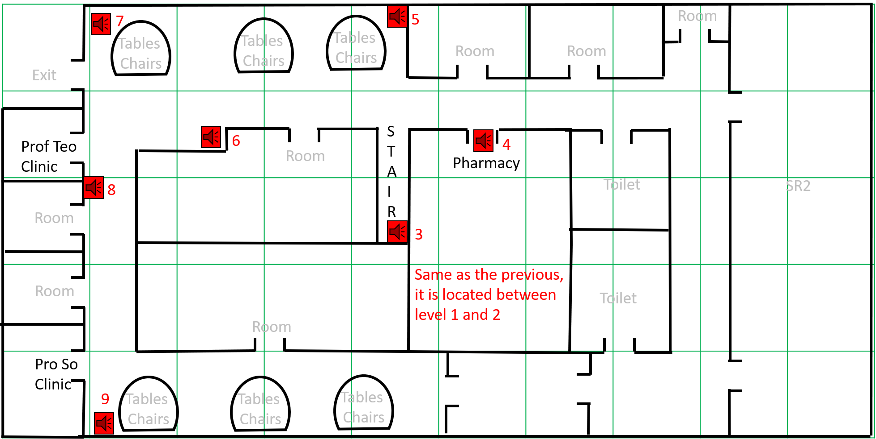

Slide 6
0 | 1 | 2 | 3 | 4 | 5 | 6 | 7 | 8 | 9 | 10 | 11 | 12 | 13 | 14 | 15 | 16 | 17 | 18 | 19 | 20 | 21 | 22 | 23 | 24 | 25 | 26 | 27 | 28 | 29 | 30 | 31 | 32 | 33 | 34 | 35 | 36 | 37 | 38 | 39 | 40 | 41 | 42 | 43 | 44 | 45 | 46 | 47 | 48 | 49 | 50 | 51 | 52 | 53 | 54 | 55 | 56 | 57 | 58 | 59
0
1
2
3
4
5
6
7
8
9
10
11
12
13
14
15
16
17
18
19
20
21
22
23
24
1 | 1 | 1 | 1 | 1 | 0
1 | 1 | 1 | 1 | 1 | 0
1 | 1 | 1 | 1 | 0 | 0
1 | 1 | 1 | 1 | 1 | 1
1 | 1 | 1 | 1 | 1 | 1
0 | 0 | 0 | 0 | 0 | 0
1 | 1 | 1 | 1 | 1 | 1
1 | 1 | 1 | 1 | 1 | 1
1 | 1 | 1 | 1 | 1 | 1
1 | 1 | 1 | 1 | 1 | 1
0 | 0 | 0 | 0 | 0 | 0
1 | 1 | 1 | 1 | 1 | 1
1 | 1 | 1 | 1 | 1 | 1
1 | 1 | 1 | 1 | 1 | 1
1 | 1 | 1 | 1 | 1 | 1
0 | 0 | 0 | 0 | 0 | 0
1 | 1 | 1 | 1 | 1 | 1
1 | 1 | 1 | 1 | 1 | 1
1 | 1 | 1 | 1 | 1 | 1
1 | 1 | 1 | 1 | 1 | 1
0 | 0 | 0 | 0 | 0 | 0
1 | 1 | 1 | 0 | 0 | 0
1 | 1 | 1 | 0 | 0 | 0
1 | 1 | 1 | 0 | 0 | 0
1 | 1 | 1 | 0 | 0 | 0
0 | 0 | 0 | 0 | 0 | 0
1 | 1 | 1 | 1 | 1 | 0
0 | 1 | 1 | 1 | 1 | 0
1 | 1 | 1 | 1 | 1 | 0
0 | 1 | 1 | 0 | 0 | 0
0 | 0 | 0 | 0 | 0 | 0
0 | 1 | 1 | 1 | 1 | 1
0 | 1 | 1 | 1 | 1 | 1
0 | 1 | 1 | 1 | 1 | 1
0 | 0 | 0 | 1 | 1 | 0
0 | 0 | 0 | 0 | 0 | 0
1 | 1 | 1 | 0 | 1 | 1
1 | 0 | 0 | 0 | 0 | 1
1 | 1 | 1 | 0 | 1 | 1
0 | 0 | 0 | 0 | 1 | 1
0 | 0 | 0 | 0 | 0 | 0
1 | 1 | 0 | 1 | 1 | 1
0 | 0 | 0 | 1 | 1 | 1
1 | 1 | 0 | 1 | 1 | 1
1 | 1 | 0 | 1 | 1 | 1
0 | 0 | 0 | 0 | 0 | 0
1 | 1 | 1 | 1 | 1 | 0
1 | 1 | 1 | 1 | 1 | 0
1 | 1 | 1 | 1 | 1 | 0
1 | 1 | 1 | 1 | 1 | 0
0
1
2
3
4
5
6
7
8
9
10
11
12
13
14
15
16
17
18
19
20
21
22
23
24
1 | 1 | 1 | 1 | 0 | 0
0 | 0 | 0 | 0 | 0 | 0
0 | 1 | 1 | 1 | 1 | 1
0 | 1 | 1 | 1 | 1 | 1
0 | 0 | 0 | 0 | 0 | 0
1 | 1 | 1 | 1 | 1 | 1
1 | 1 | 1 | 1 | 1 | 1
1 | 1 | 1 | 1 | 1 | 1
1 | 1 | 0 | 0 | 0 | 0
1 | 1 | 0 | 0 | 1 | 1
1 | 1 | 1 | 1 | 1 | 1
1 | 1 | 1 | 1 | 1 | 1
1 | 1 | 1 | 0 | 0 | 0
0 | 0 | 0 | 0 | 0 | 0
1 | 1 | 1 | 1 | 1 | 1
1 | 1 | 1 | 1 | 1 | 1
1 | 1 | 1 | 1 | 1 | 1
0 | 0 | 1 | 1 | 0 | 0
1 | 1 | 1 | 1 | 1 | 1
1 | 1 | 1 | 1 | 1 | 1
1 | 1 | 1 | 1 | 1 | 1
1 | 1 | 1 | 1 | 1 | 1
0 | 0 | 1 | 1 | 0 | 0
1 | 0 | 1 | 1 | 0 | 1
1 | 0 | 1 | 1 | 0 | 1
1 | 1 | 1 | 1 | 1 | 1
1 | 1 | 1 | 1 | 1 | 1
0 | 0 | 1 | 1 | 0 | 0
1 | 1 | 1 | 1 | 1 | 1
1 | 1 | 1 | 1 | 1 | 1
1 | 1 | 1 | 1 | 1 | 1
1 | 1 | 1 | 1 | 1 | 1
0 | 0 | 0 | 0 | 0 | 0
1 | 1 | 1 | 0 | 0 | 0
1 | 1 | 1 | 0 | 1 | 1
1 | 1 | 1 | 1 | 1 | 1
1 | 1 | 1 | 1 | 1 | 1
1 | 0 | 0 | 0 | 1 | 1
1 | 1 | 1 | 0 | 1 | 1
1 | 1 | 1 | 0 | 1 | 1
1 | 1 | 1 | 1 | 1 | 1
1 | 1 | 1 | 1 | 1 | 1
1 | 1 | 0 | 1 | 1 | 1
1 | 1 | 0 | 1 | 1 | 1
1 | 1 | 0 | 1 | 1 | 1
1 | 1 | 1 | 1 | 1 | 0
1 | 1 | 1 | 1 | 1 | 0
1 | 1 | 1 | 1 | 1 | 0
1 | 1 | 1 | 1 | 1 | 0
1 | 1 | 1 | 1 | 1 | 0
0 | 0 | 0 | 0 | 0 | 0
0 | 1 | 1 | 1 | 1 | 1
0 | 1 | 1 | 1 | 1 | 1
0 | 0 | 0 | 0 | 0 | 0
0 | 0 | 0 | 0 | 0 | 0
1 | 1 | 0 | 0 | 1 | 1
1 | 1 | 0 | 0 | 1 | 1
1 | 1 | 0 | 0 | 1 | 1
1 | 1 | 0 | 0 | 0 | 0
1 | 1 | 0 | 0 | 0 | 0
1 | 1 | 1 | 1 | 1 | 1
1 | 1 | 1 | 1 | 1 | 1
1 | 1 | 1 | 1 | 1 | 1
0 | 0 | 0 | 0 | 0 | 0
0 | 0 | 0 | 0 | 0 | 0
1 | 1 | 1 | 1 | 1 | 1
1 | 1 | 1 | 1 | 1 | 1
1 | 1 | 1 | 1 | 1 | 1
0 | 0 | 0 | 0 | 0 | 0
0 | 0 | 0 | 0 | 0 | 0
1 | 0 | 1 | 1 | 0 | 1
1 | 0 | 1 | 1 | 0 | 1
1 | 0 | 1 | 1 | 0 | 1
0 | 0 | 0 | 0 | 0 | 1
0 | 0 | 0 | 0 | 0 | 1
1 | 1 | 1 | 1 | 1 | 1
1 | 1 | 1 | 1 | 1 | 1
1 | 1 | 1 | 1 | 1 | 1
1 | 1 | 1 | 1 | 1 | 1
1 | 1 | 1 | 1 | 1 | 1
1 | 1 | 1 | 0 | 1 | 1
1 | 1 | 1 | 0 | 1 | 1
1 | 1 | 1 | 0 | 0 | 0
1 | 1 | 1 | 0 | 0 | 0
1 | 1 | 1 | 0 | 1 | 1
1 | 1 | 1 | 0 | 1 | 1
1 | 1 | 1 | 0 | 1 | 1
0 | 0 | 0 | 0 | 1 | 1
0 | 0 | 0 | 0 | 1 | 1
1 | 1 | 1 | 0 | 1 | 1
1 | 1 | 0 | 1 | 1 | 1
1 | 1 | 0 | 1 | 1 | 1
1 | 1 | 0 | 1 | 1 | 1
1 | 1 | 0 | 1 | 1 | 1
1 | 1 | 0 | 1 | 1 | 1
1 | 1 | 1 | 1 | 1 | 0
1 | 1 | 1 | 1 | 1 | 0
1 | 1 | 1 | 1 | 1 | 0
1 | 1 | 1 | 1 | 1 | 0
1 | 1 | 1 | 1 | 1 | 0
0 | 1 | 1 | 1 | 1 | 0
0 | 1 | 1 | 1 | 1 | 1
0 | 1 | 1 | 1 | 1 | 0
0 | 0 | 0 | 0 | 0 | 0
0 | 1 | 1 | 1 | 1 | 0
1 | 1 | 0 | 0 | 1 | 1
1 | 1 | 0 | 0 | 1 | 1
1 | 1 | 0 | 0 | 1 | 1
1 | 1 | 0 | 0 | 1 | 1
1 | 1 | 0 | 0 | 0 | 0
1 | 1 | 1 | 1 | 1 | 1
1 | 1 | 1 | 1 | 1 | 1
1 | 1 | 1 | 1 | 1 | 1
1 | 1 | 1 | 1 | 1 | 1
0 | 0 | 0 | 0 | 0 | 1
1 | 1 | 1 | 1 | 1 | 1
1 | 1 | 1 | 1 | 1 | 1
1 | 1 | 1 | 1 | 1 | 1
1 | 1 | 1 | 1 | 1 | 1
1 | 0 | 0 | 0 | 0 | 0
1 | 1 | 1 | 0 | 0 | 1
1 | 1 | 1 | 0 | 0 | 1
1 | 1 | 1 | 0 | 0 | 1
1 | 1 | 1 | 0 | 0 | 1
0 | 0 | 0 | 0 | 0 | 0
1 | 1 | 1 | 1 | 1 | 1
1 | 1 | 1 | 1 | 1 | 1
1 | 1 | 1 | 1 | 1 | 1
1 | 1 | 1 | 1 | 1 | 1
0 | 0 | 0 | 0 | 0 | 0
1 | 1 | 1 | 0 | 1 | 1
1 | 1 | 1 | 0 | 1 | 1
1 | 1 | 1 | 0 | 1 | 1
1 | 1 | 1 | 0 | 1 | 1
0 | 0 | 0 | 0 | 0 | 0
1 | 1 | 1 | 0 | 1 | 1
1 | 1 | 1 | 0 | 1 | 1
1 | 1 | 1 | 0 | 1 | 1
1 | 1 | 1 | 0 | 1 | 1
1 | 1 | 0 | 0 | 1 | 1
1 | 1 | 0 | 1 | 1 | 1
1 | 1 | 0 | 1 | 1 | 1
1 | 1 | 0 | 1 | 1 | 1
1 | 1 | 0 | 1 | 1 | 1
1 | 1 | 0 | 1 | 1 | 1
1 | 1 | 1 | 1 | 1 | 0
1 | 1 | 1 | 1 | 1 | 0
1 | 1 | 1 | 1 | 1 | 0
1 | 1 | 1 | 1 | 1 | 0
1 | 1 | 1 | 1 | 1 | 0
0 | 1 | 1 | 1 | 1 | 1
0 | 1 | 1 | 1 | 1 | 1
0 | 1 | 1 | 1 | 1 | 0
0 | 1 | 1 | 1 | 1 | 0
0 | 0 | 0 | 0 | 0 | 0
1 | 1 | 0 | 0 | 0 | 0
1 | 1 | 1 | 1 | 1 | 1
1 | 1 | 1 | 1 | 1 | 1
1 | 1 | 1 | 1 | 1 | 1
0 | 0 | 0 | 0 | 0 | 0
0 | 0 | 0 | 0 | 0 | 1
1 | 1 | 1 | 1 | 1 | 1
1 | 1 | 1 | 1 | 1 | 1
1 | 1 | 1 | 1 | 1 | 1
0 | 0 | 0 | 0 | 0 | 0
1 | 0 | 0 | 0 | 0 | 0
1 | 1 | 1 | 1 | 1 | 1
1 | 1 | 1 | 1 | 1 | 1
1 | 1 | 1 | 1 | 1 | 1
0 | 0 | 0 | 0 | 0 | 0
0 | 0 | 0 | 0 | 0 | 0
1 | 1 | 1 | 1 | 1 | 1
1 | 1 | 1 | 1 | 1 | 1
1 | 1 | 1 | 1 | 1 | 1
0 | 0 | 0 | 0 | 0 | 0
0 | 0 | 0 | 0 | 0 | 0
0 | 1 | 1 | 1 | 1 | 1
1 | 1 | 1 | 1 | 1 | 1
0 | 1 | 1 | 1 | 1 | 1
0 | 0 | 0 | 0 | 0 | 0
0 | 0 | 0 | 0 | 0 | 0
1 | 1 | 1 | 1 | 0 | 1
1 | 1 | 1 | 1 | 1 | 1
1 | 1 | 1 | 1 | 1 | 1
0 | 0 | 0 | 0 | 0 | 0
1 | 1 | 0 | 0 | 1 | 1
1 | 1 | 1 | 1 | 1 | 1
1 | 1 | 1 | 1 | 1 | 1
1 | 1 | 1 | 1 | 1 | 1
0 | 0 | 0 | 0 | 0 | 0
1 | 1 | 0 | 1 | 1 | 1
1 | 1 | 1 | 1 | 1 | 1
1 | 1 | 1 | 1 | 1 | 1
1 | 1 | 0 | 1 | 1 | 1
0 | 0 | 0 | 0 | 0 | 0
1 | 1 | 1 | 1 | 1 | 0
1 | 1 | 1 | 1 | 1 | 0
1 | 1 | 1 | 1 | 1 | 0
1 | 1 | 1 | 1 | 1 | 0
0 | 0 | 0 | 0 | 0 | 0
0 | 1 | 2 | 3 | 4 | 5 | 6 | 7 | 8 | 9 | 10 | 11 | 12 | 13 | 14 | 15 | 16 | 17 | 18 | 19 | 20 | 21 | 22 | 23 | 24 | 25 | 26 | 27 | 28 | 29 | 30 | 31 | 32 | 33 | 34 | 35 | 36 | 37 | 38 | 39 | 40 | 41 | 42 | 43 | 44 | 45 | 46 | 47 | 48 | 49 | 50 | 51 | 52 | 53 | 54 | 55 | 56 | 57 | 58 | 59

